Slide 1
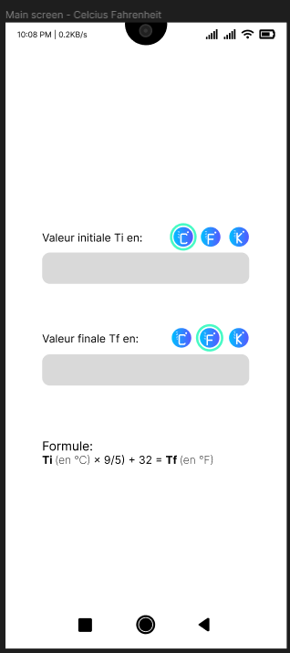
Screen view division
View 1
View 1:
Texte
Images
Input area
View 2:
Texte
View 1
View 2

